Slide 1
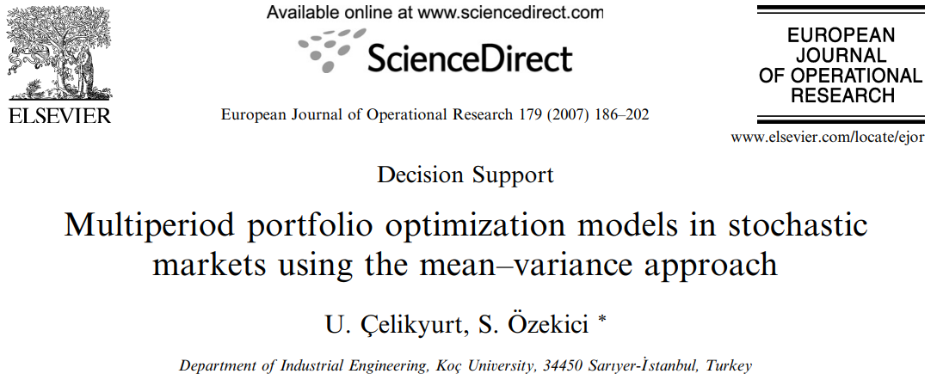
By Subhadeep Paul

Slide 2
Assumptions
Market consists of a riskless asset and several risky assets.
The returns in any period are random with a mean vector and a covariance matrix that depend on the prevailing economic conditions in the market during that period.
Objective functions depend only on the mean and the variance of the final wealth.
An auxiliary problem that generates the same efficient frontier as our formulations is solved using dynamic programming to identify optimal portfolio management policies for each problem.

Slide 3
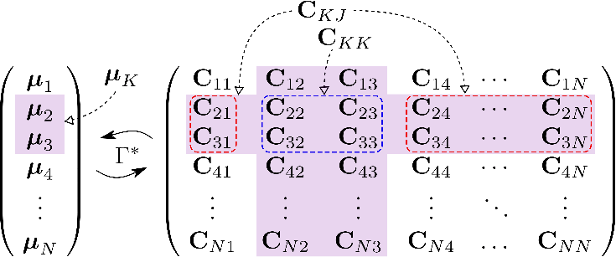
Mean vector and Covariance Matrix

Slide 4
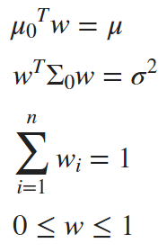
Portfolio Notations
Portfolio return
Return on each asset
Portfolio Variance
Variance Covariance Matrix
Relating assets to one another
Weights

Slide 5
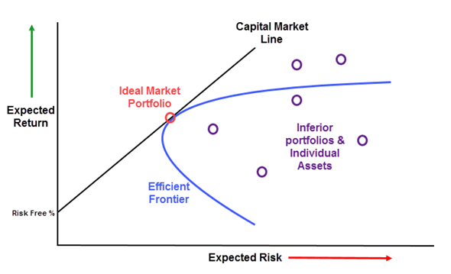
Efficient Frontier
An efficient frontier is a set of investment portfolios that are expected to provide the highest returns at a given level of risk. A portfolio is said to be efficient if there is no other portfolio that offers higher returns for a lower or equal amount of risk.

Slide 6
Introduction

Slide 7
Disadvantages of SPO based on Mean-Variance Method
Normality assumption: The mean-variance method assumes that asset returns are normally distributed. However, real-world returns are often not normally distributed, especially during extreme events. This can lead to underestimation of portfolio risk.
Static inputs: The mean-variance method assumes that the inputs (e.g., variances and correlations) are static and do not change over time. However, in reality, these inputs can change frequently. This can lead to suboptimal portfolio allocations.
Estimation error: The mean-variance method is sensitive to estimation error. This means that even small errors in the estimates of expected returns or variances can lead to significant changes in the optimal portfolio allocation.
Single-period framework: The mean-variance method assumes that investors make their asset allocation decisions once and for all at the beginning of a period. However, in reality, investors may need to adjust their asset allocations over time.

Slide 8
Models Used in the Paper
Early portfolio problems focused on maximizing expected gain: This approach is based on the idea that investors want to maximize the amount of money they make from their investments. However, some investors may be more risk-averse and prefer to minimize the risk of losing money, even if it means sacrificing some potential gains.
The safety-first problem is an alternative to the classical mean-variance concept: The safety-first problem is a more conservative approach to portfolio selection. It aims to minimize the probability that the terminal wealth of an investor is below a predetermined level, also known as the disaster level. This approach is suitable for investors who are risk-averse and want to minimize the chance of losing money.
The quadratic utility function is a commonly used function to describe investor preferences: The quadratic utility function is a flexible function that can be used to model a variety of investor preferences. It is often used to represent the preferences of risk-averse investors. The quadratic utility function can be used to maximize the expected utility at the end of the investment horizon, which is a measure of how satisfied an investor is with their investment returns.

Slide 9
The stochastic market

Slide 10
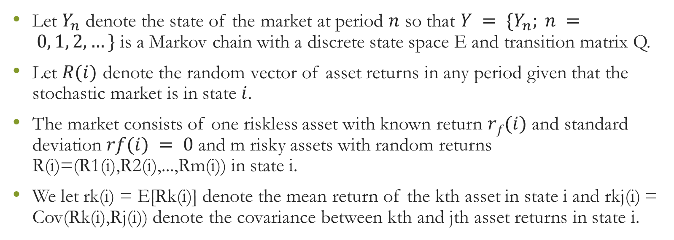
The stochastic market
Let $Y_{n}$ denote the state of the market at period $n$ so that $Y = \{Y_{n}; n = 0, 1, 2,…\}$ is a Markov chain with a discrete state space E and transition matrix Q.
Let $R(i)$ denote the random vector of asset returns in any period given that the stochastic market is in state $i$.
The market consists of one riskless asset with known return $rf(i)$ and standard deviation $rf(i) = 0$and m risky assets with random returns R(i)=(R1(i),R2(i),...,Rm(i)) in state i.
We let rk(i) = E[Rk(i)] denote the mean return of the kth asset in state i and rkj(i) = Cov(Rk(i),Rj(i)) denote the covariance between kth and jth asset returns in state i.

Slide 11


Equations
Expected return on each asset and covariance
Future Expected investor’s wealth and distribution of assets

Slide 13
Mean–variance model formulations

Slide 14
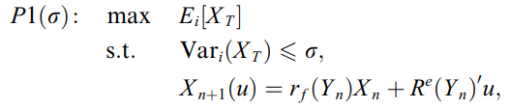
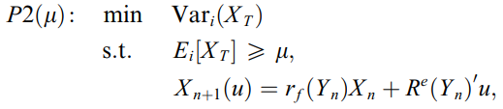


Formulation
Maximizing Returns with limited Risk
Minimizing Risk with baseline returns
Combined problem
Tractable auxiliary problem

Slide 15
Solution of the auxiliary problem

Slide 16
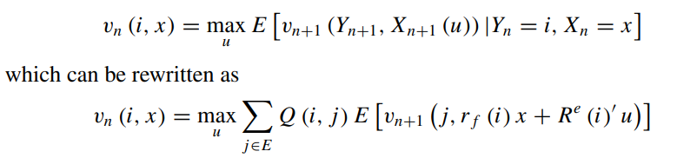
Dynamic Programming Solution
All possible
portfolios
Future
State
Future amount
of money
Current
State
Current amount
of money
The authors have solved the problem using Matrix multiplication methods

Slide 17
General utility functions

Slide 18

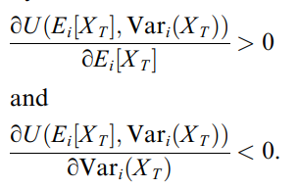
Utility function
Subject to conditions
The authors have solved the problem using partial differentiation methods

Slide 19
Quadratic utility model

Slide 20
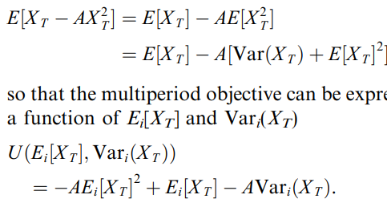
Quadratic Models
Tractable auxiliary problem

Slide 21
Thank You

Slide 22
Why not use ML/DL for this?

